Slide 1
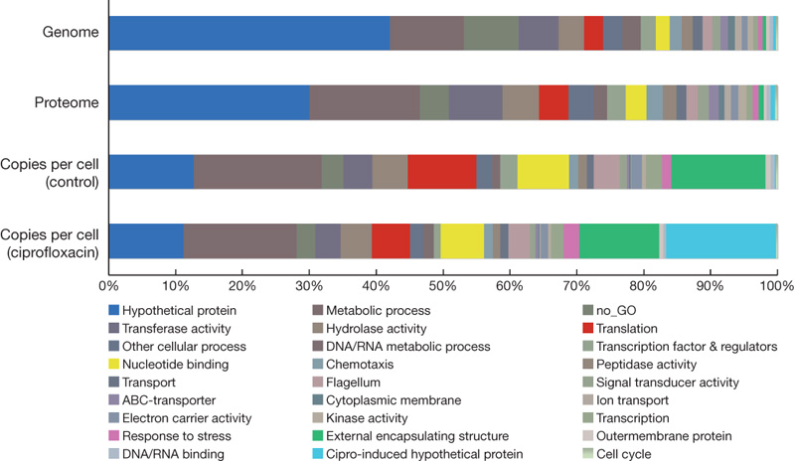

Abundance levels of selected protein groups, by Gene Ontology analysis.
J Malmström et al. Nature 000, 1-4 (2009) doi:10.1038/nature08184

